Slide 1
The Essential Project
Data Set API Generator v1 Guide

Slide 2
Features

Slide 3
Features
The Data Set API Generator provides the ability to specify the classes and slots that you wish to retrieve the data for.
You can search and select the classes/slots available from the repository.
You can either:
  Create the XSL required for an Essential view template which embeds the XSL in an XSL/HTML/Javascript template.
  Create the XSL required for a Data Set API which provides the data in a flat JSON structure. This could be used as a Data Set for the Essential Power BI Data Set API connector.
Supports Lifecycles (including any styling applied)
Supports Stakeholders
You can visualize the specification/meta-model you have defined
You can also export/import the specification you have defined

Slide 4
How to install
Apply the Data Set API Generator .DUP file to the repository which you plan to create views for
If you have extended the meta-model or added any custom slots, please ensure you use the generator from this repository as you will be given a list of classes/slots to select from.
NOTE: on every load of the Data Set API Generator, it may take several seconds for it to load as it needs to retrieve a list of the classes/slots that you will be selecting from.

Slide 5
Use cases

Slide 6
Use cases
To create a new custom view
To retrieve additional properties required for an existing view (i.e. adding the data for custom slots into existing views)
To create a Data Set API which provides the data in a JSON structure
  You could use this to create a new Power BI data set by:-
    Classifying the Data Set API as “BI Reporting API"
    report_implementation_type slot set to “reference”

Slide 7
Creating a specification

Slide 8
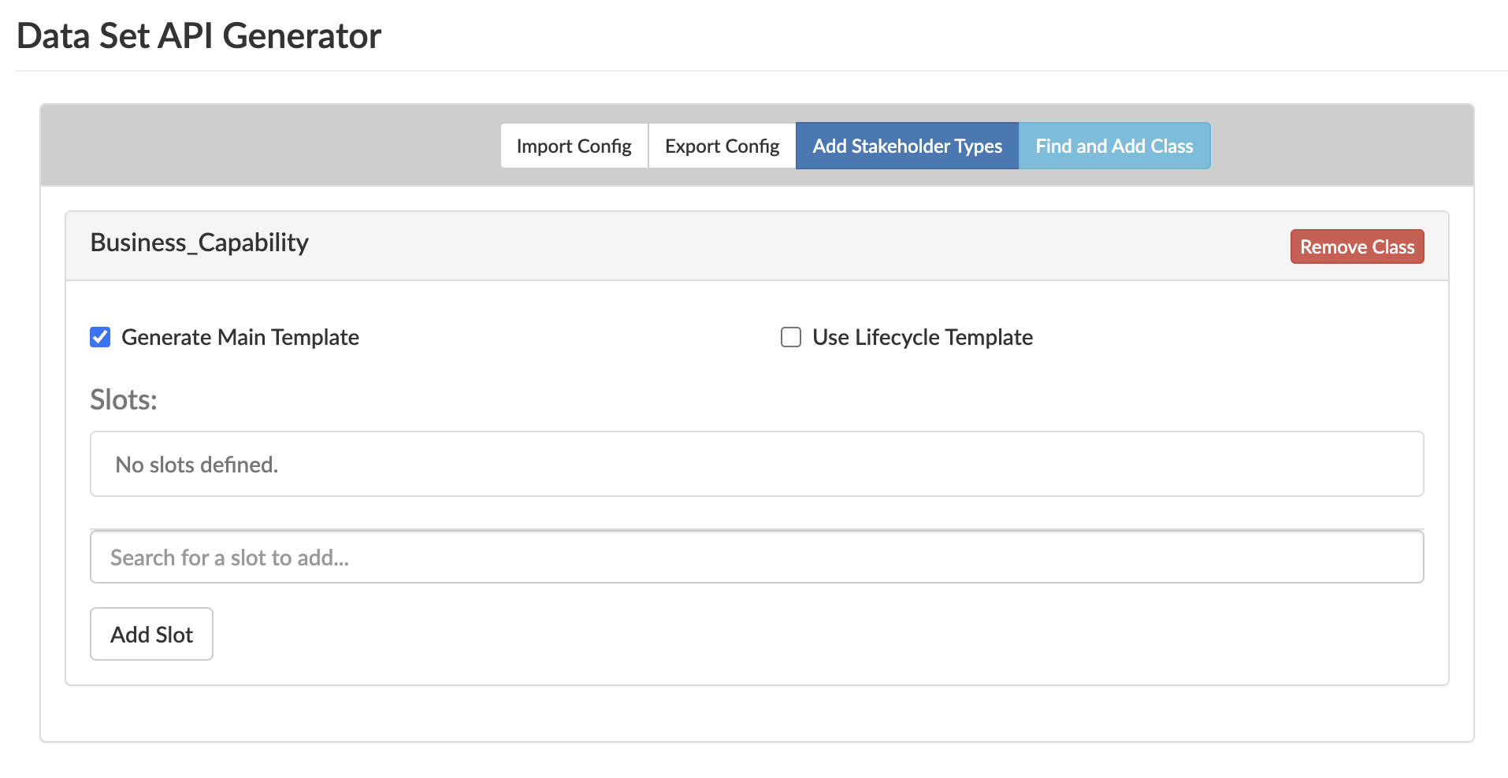
Firstly, click this button to search for a class to add to the schema
If you have added a class which is an enumeration, you can select this option to automatically retrieve: id, name, short_name, colour, text colour, and enumeration sequence number
(Styling if set-up will automatically be retrieved)
By default, every class will include the name, className, and id property automatically, but you may want to add other slots to retrieve data for
Selecting this option will result in the class being listed at the top-level of the resulting JSON data structure.

Slide 9
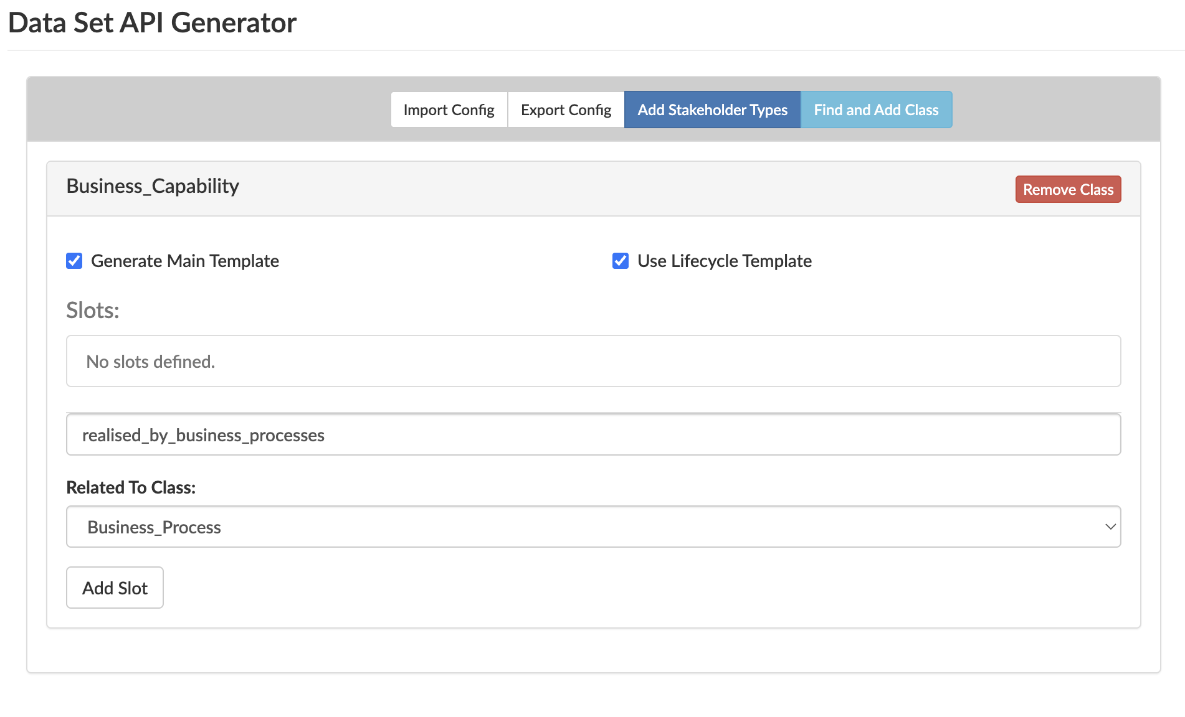
Adding an Instance slot
We have selected an Instance slot which refers to another class
In some cases, you will have several options of classes to select from. After clicking Add Slot, if the class does not already exist, the related class will automatically be added to the specification.

Slide 10
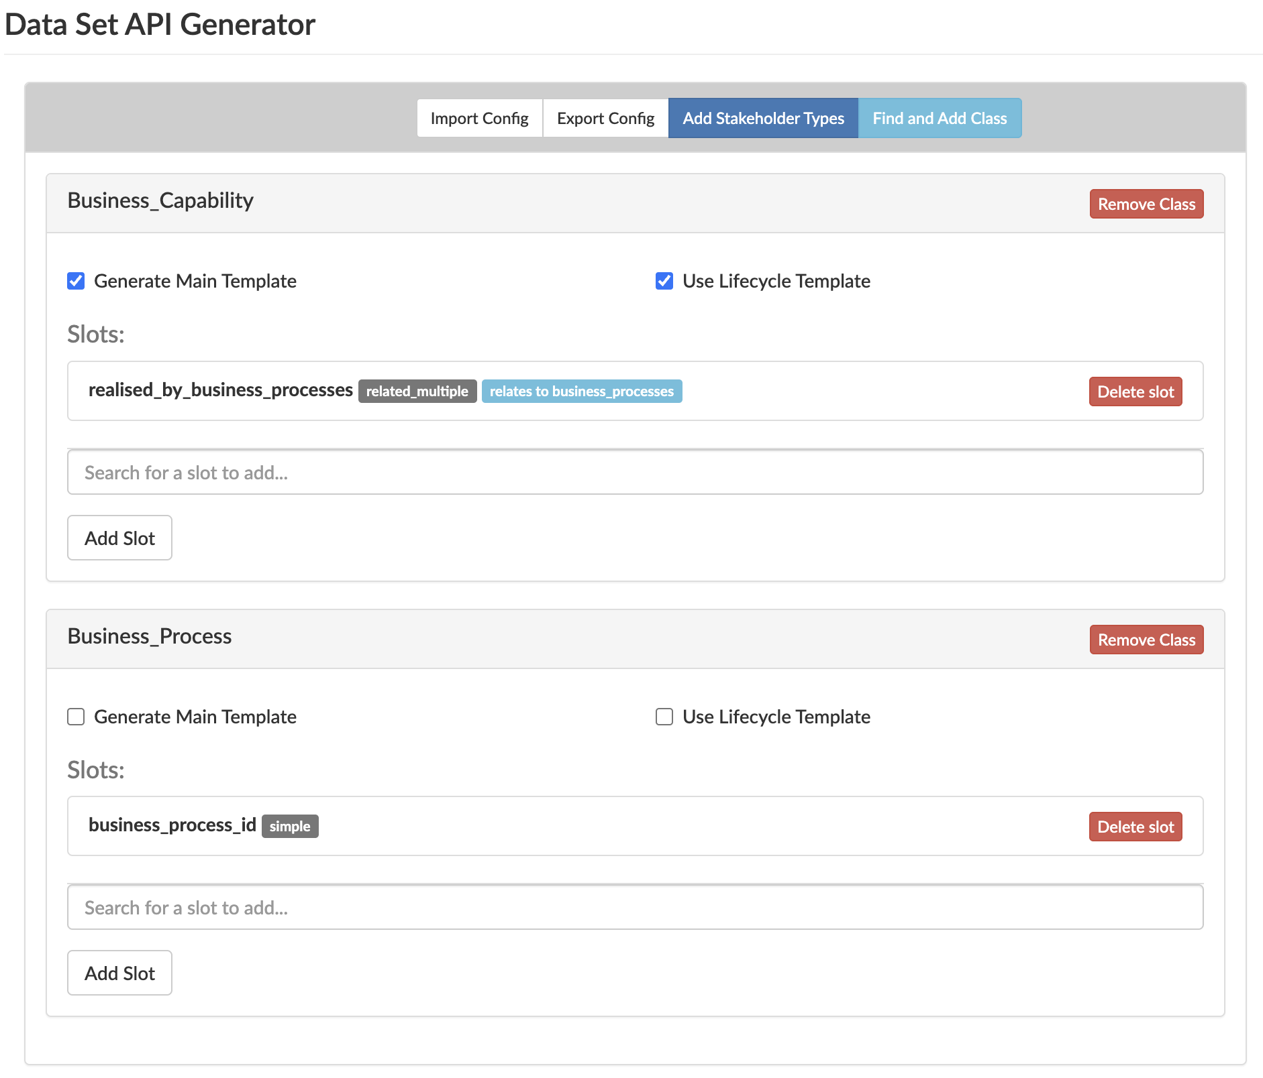
Related classes
This instance slot refers to the Business_Process class template
We have unchecked this option, as the template does not need to be defined at the top-level as it will be nested within the Business_Capability class
As an example, we have included a simple string slot which is not related to anything, but you could add further instance slots which would refer to other classes.

Slide 11
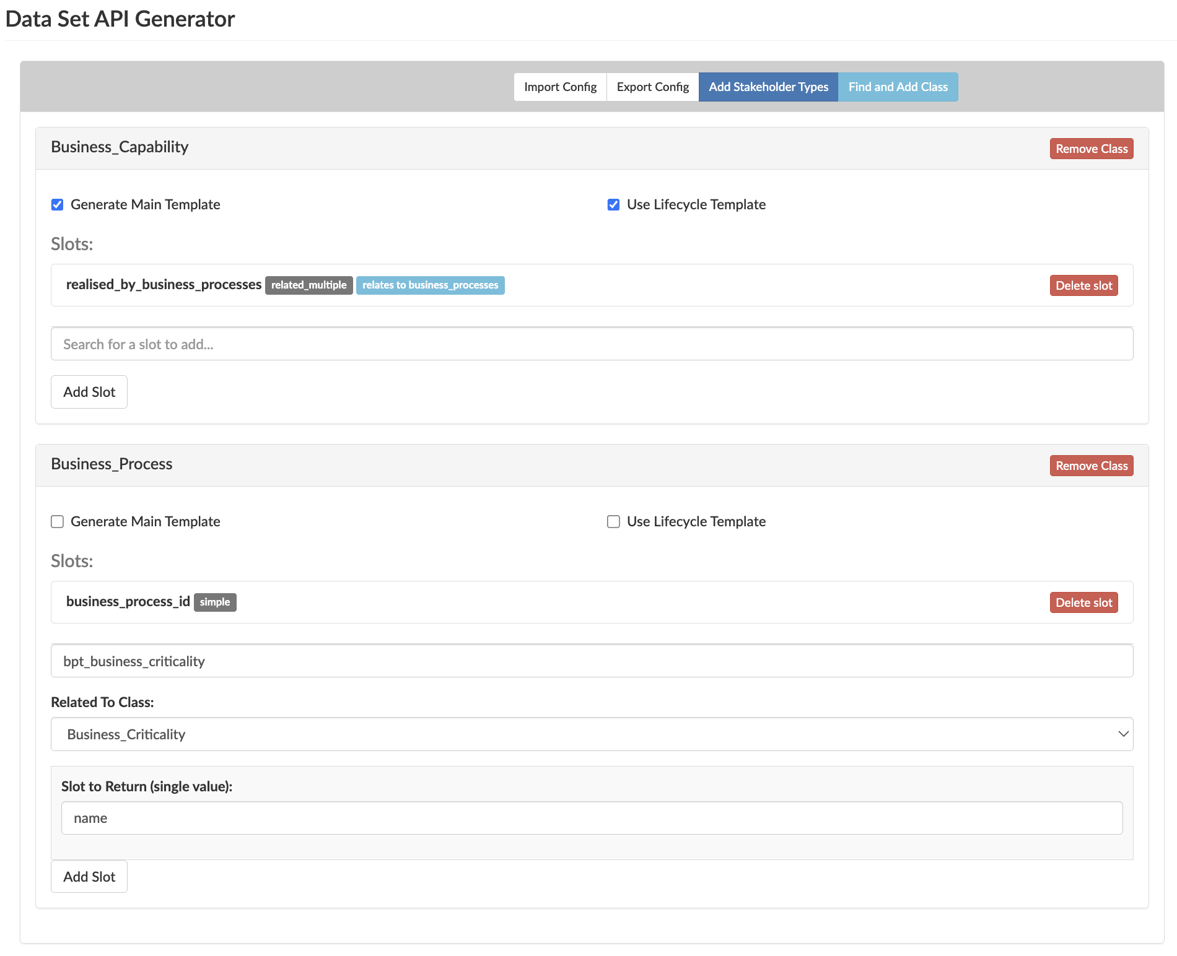
Related single instance classes
This Single instance slot refers to the Business_Criticality class
Crucially, when adding single instance slots, you can only retrieve one slot value. You cannot currently return the id of the related single instance.

Slide 12
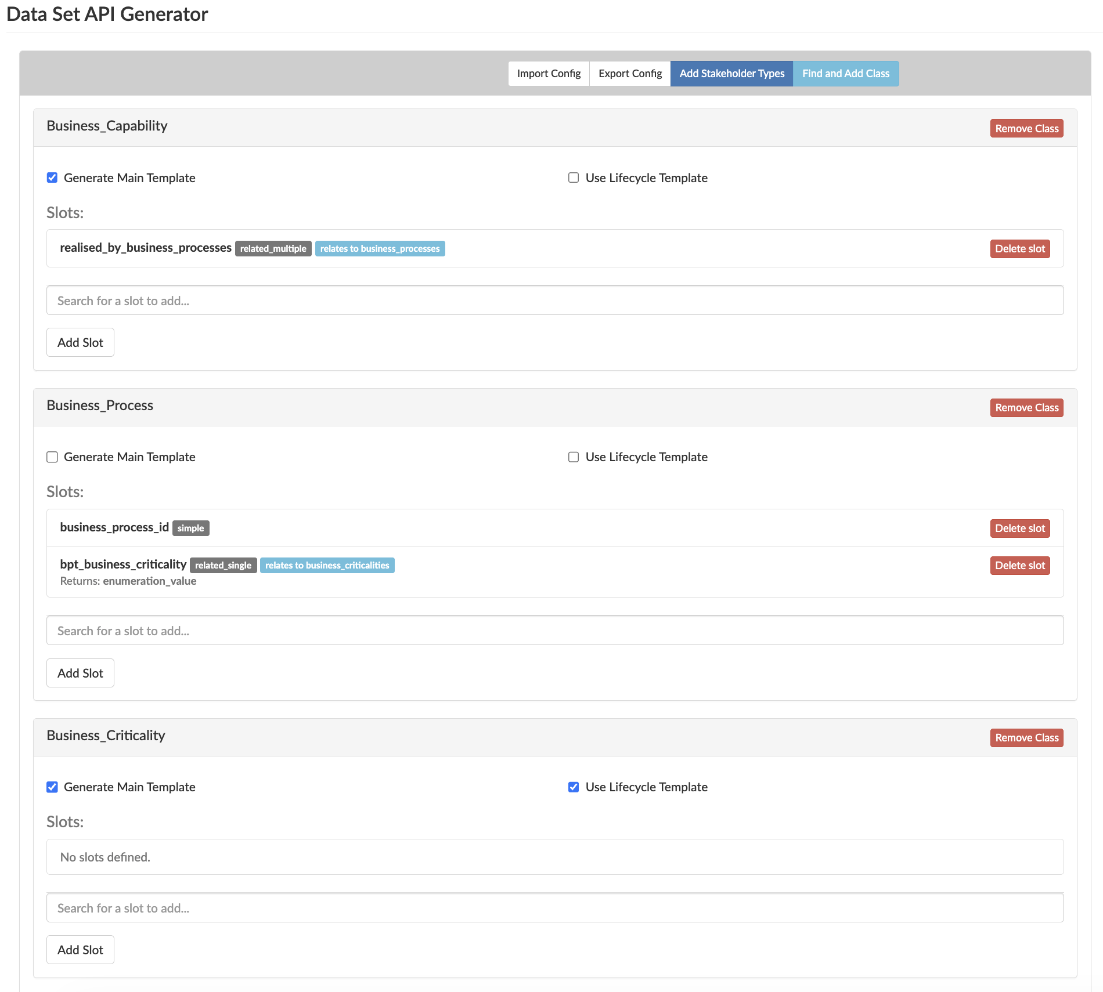
Example
We have selected the enumeration_value slot for Business Criticality
Business_Criticality is an enumeration, so we have selected the Lifecycle Template.
For a custom view, to use the styling, the business_criticalities array that is generated could be used to apply any styling set using Javascript.
For single related instances we cannot nest the Criticality template within the Business Process class, so we want this class defined at the top-level

Slide 13
Stakeholder Types
BEFORE using the stakeholders slot for a class, you will need to click the Add Stakeholder Types button. You will only need to do this once in a single specification.
For the given class, enter “stakeholders” and you will need to set the related to class as “ACTOR_TO_ROLE_RELATION”
The resulting XSL will provide everything you need for stakeholders which includes the following classes:-
  Individual/Group Actor
  Individual/Group Business Role
  ACTOR_TO_ROLE_RELATION

Slide 14
Generating and installing the view template

Slide 15
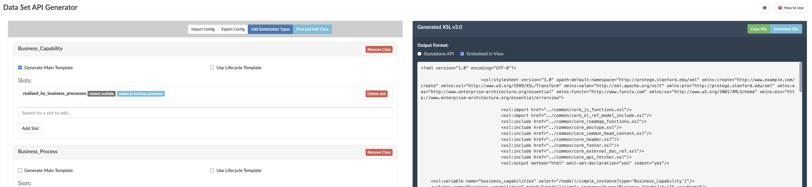
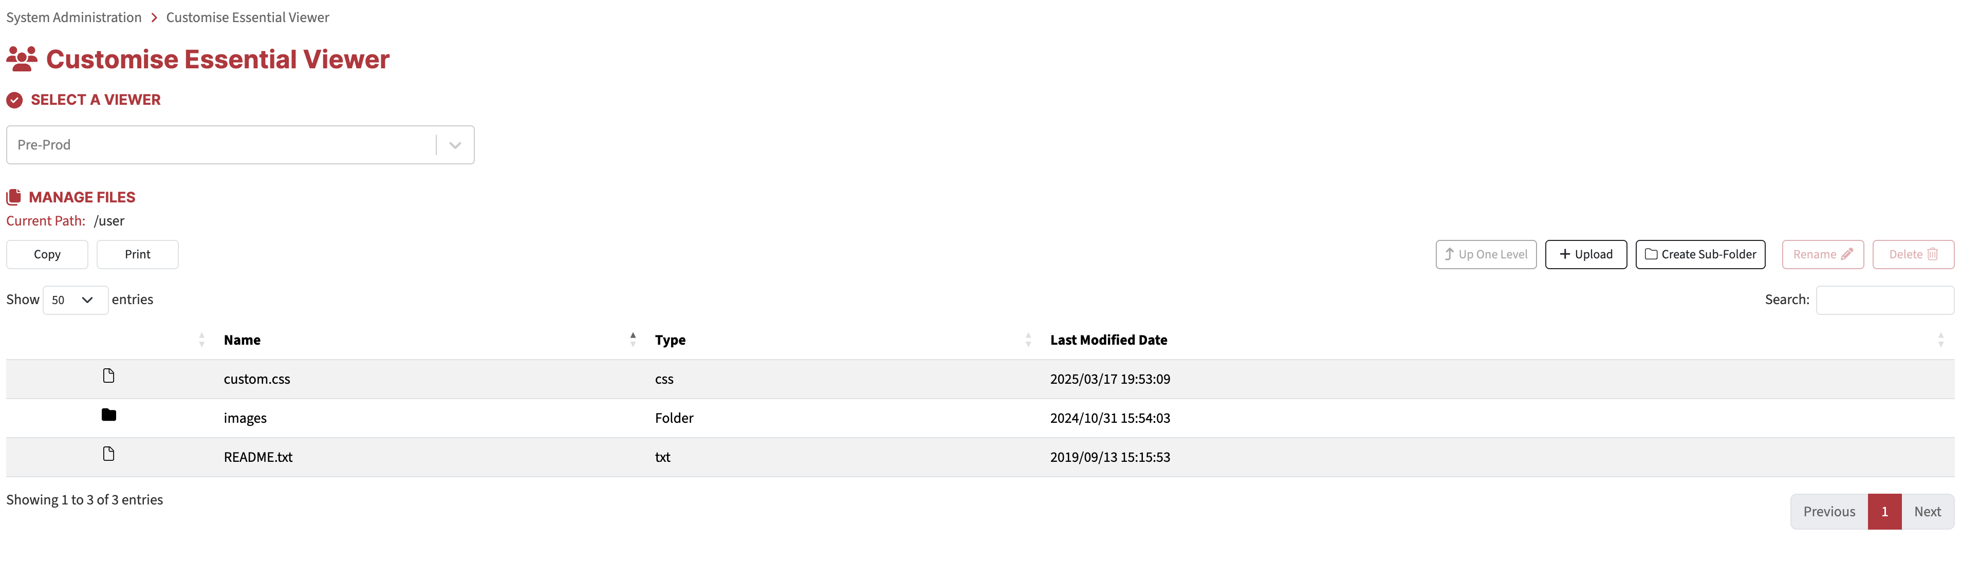
Download the XSL generated
Click the Download XSL button
Then go to Essential Dashboard > Configure > System Administration > View Management
Upload the XSL document to the relevant repository

Slide 16
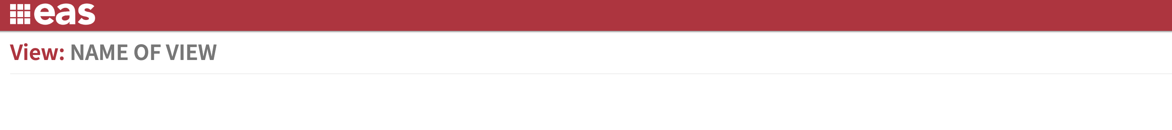
Navigate to the generated view template
Open the viewer where you are initially taken to the Knowledge Portal with the following URL: https://<Tenant>.essentialintelligence.com/viewer/<Tenant ID>_<Repository number>/report?XML=reportXML.xml&XSL=home.xsl&cl=en-gb&LABEL=Home
In the URL, replace everything after the XSL= parameter with “user/Essential_View_Template_YourUsername_DDMMYYYY.xsl”
  https://<Tenant>.essentialintelligence.com/viewer/<Tenant ID>_<Repository number>/report?XML=reportXML.xml&XSL= user/Essential_View_Template_YourUsername_DDMMYYYY.xsl
You should see a blank view template like above

Slide 17
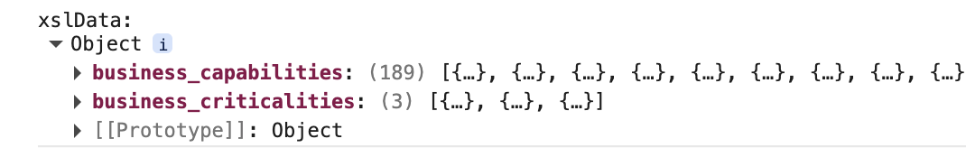
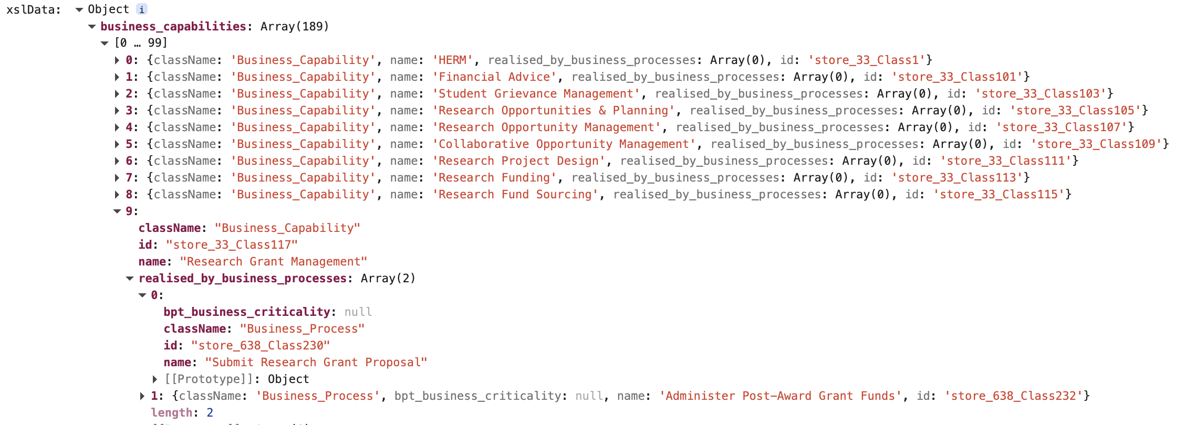
Verify the data has been retrieved
Using your web-browsers inspect tool, on the webpage check the console for the property xslData
The ‘main templates’ we defined in the generator
The nested Business Processes

Slide 18
Data Set API data retrieval

Slide 19
Data Set APIs
Essential has a number of pre-defined data sets which output the data in JSON format. These are created and referred to under the Data_Set_API class.
The report_xsl_filename slot refers to the location where the XSL file is held (the code retrieving the data)
The dsa_data_label slot is what you will refer to if you would like to retrieve data for an existing Data Set API (e.g. appMartAPI)
Essential views may retrieve data by using the Data Set API method, embedded XSL, or using both methods.

Slide 20
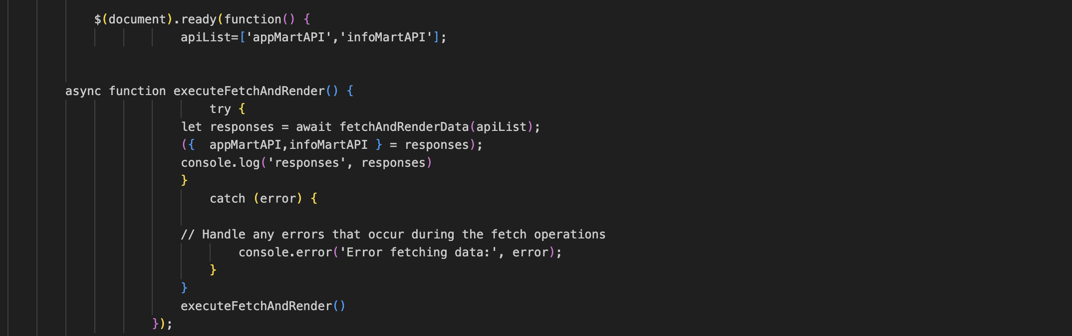
Data Set API data retrieval
Define the dsa_data_label here for the data sets you wish to retrieve
Add any additional code you require within the try block

Slide 21
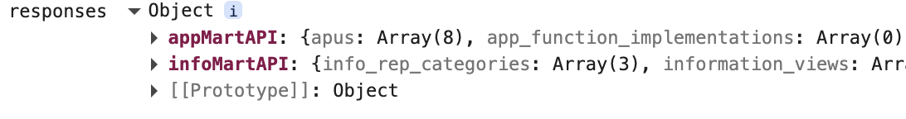
Verify Data Set API data retrieval
Using your web-browsers inspect tool, on the webpage check the console for the property responses
Your view can access the data retrieved: responses.<dsa_data_label>

Slide 22
Essential Project

